Slide 1

World development measure clustering
Project 221- Group 1
Project Guide
Mr. Iftekar Patel
Team Members
Madan K
Kuldeep Mishra
Balaji Nagarajan
Diwakar Murugan
Vansh Shyam Shrivastava
Project Co-ordinator
Hareesh K C

Slide 2
Business objective
Our Objective is to Create clusters on Global development measurement dataset.
The dataset has information about important economic and development metrics related to various countries across the globe.
The dataset have features 25 features in total and 2704 records in total
Form this dataset to build a clustering model predicting the development status of the country .

Slide 3
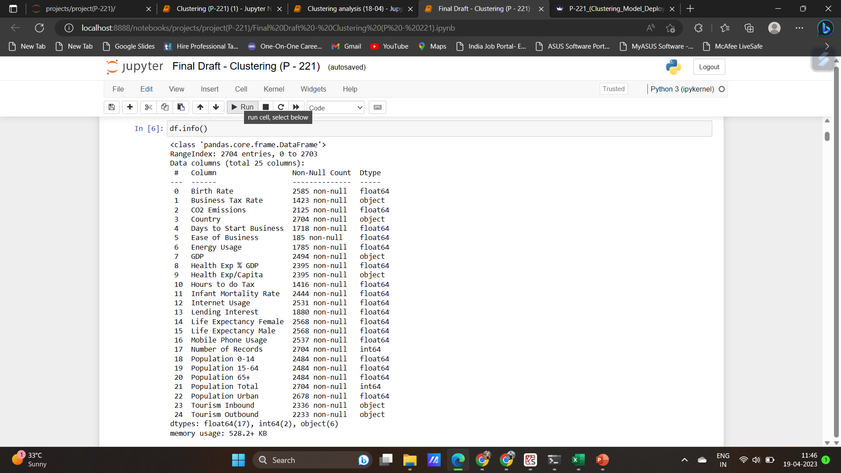
Dataset details:
The available features of the dataset are shown.
Some of the features are non numerical and also some null values are present in the dataset
This dataset contains total of 13 records for 208 countries.
These 13 entries are 13years from 2000-2013

Slide 4
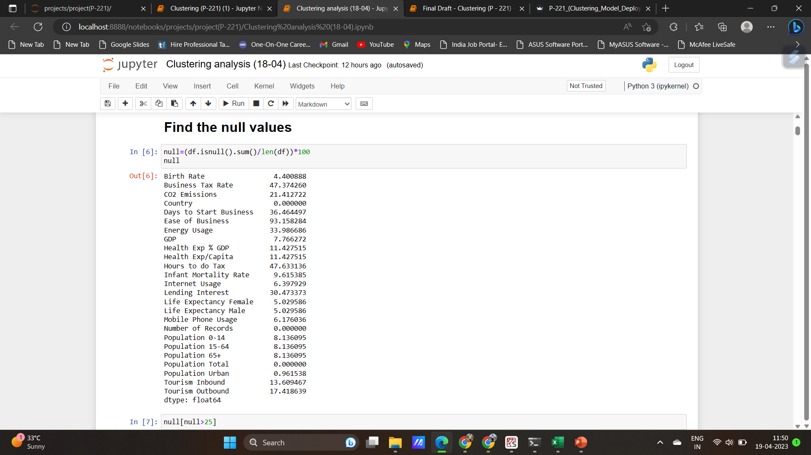
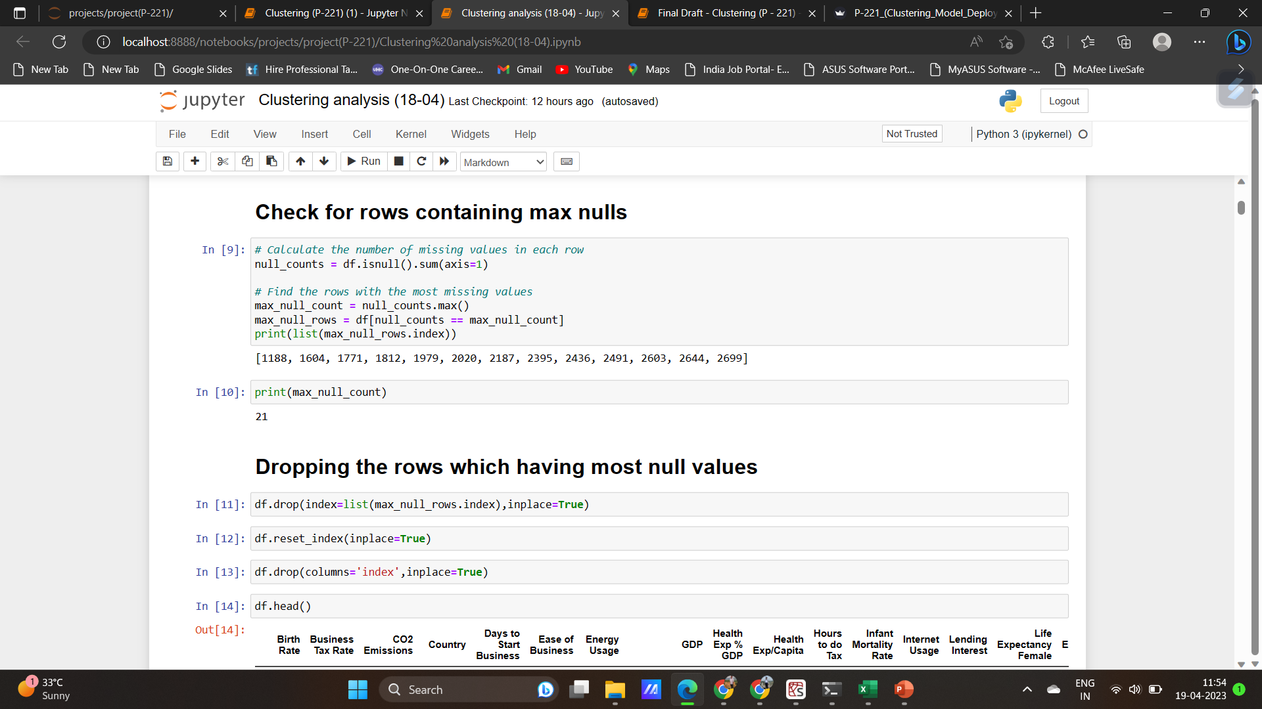
Null values
The percentage of null values of the individual features
To carryover the work of imputation on these features
We have also checked for the rows with most null entries and removed those rows.
Multiple imputation: This method generates multiple imputed datasets by simulating plausible values for the missing values based on the observed data and the uncertainty associated with the missingness. This method can be useful when there is significant missing data and a single imputation method may not be sufficient

Slide 5
Correlation between the features
Since we multiple features we have to check for the correlation between the features because the two highly correalted features provide the same information and in this case we may just use one of the feature.
The following columns are highly correlated:
{('Birth Rate', 'Population 0-14'), ('Life Expectancy Female', 'Life Expectancy Male'), ('Life Expectancy Male', 'Life Expectancy Female'), ('Birth Rate', 'Infant Mortality Rate'), ('Infant Mortality Rate', 'Population 0-14'), ('Energy Usage', 'CO2 Emissions'), ('Population 0-14', 'Birth Rate'), ('Population 0-14', 'Infant Mortality Rate'), ('CO2 Emissions', 'Energy Usage'), ('Infant Mortality Rate', 'Birth Rate’)}
From this we can come to conclusion that some features like if energy usage is high the co2 emission would be high and also that birth rate and infant mortality rate are both moreover same in case

Slide 6
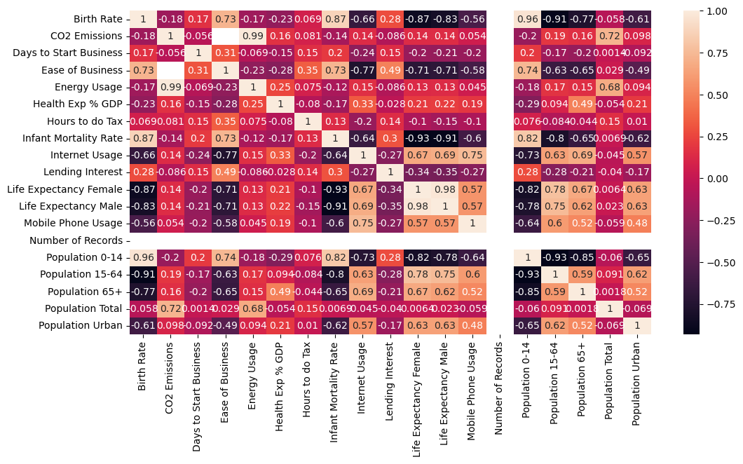
Heatmap providing information about correlation

Slide 7
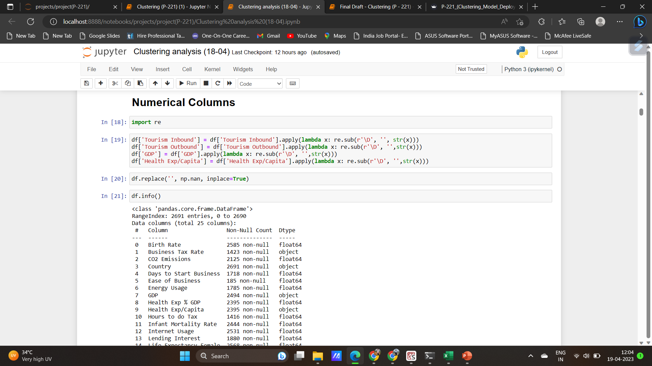
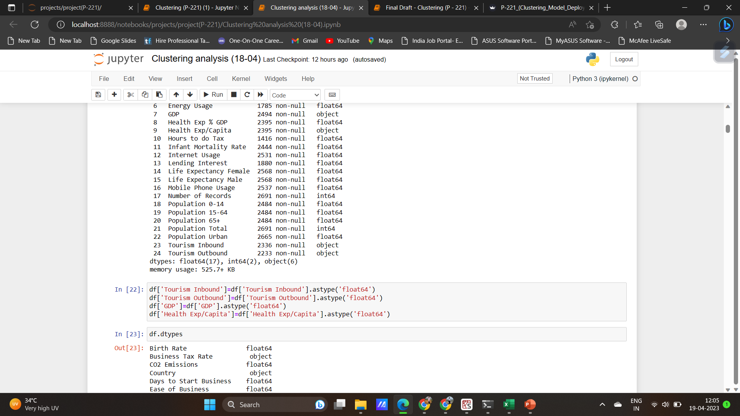
Preprocessing of the features:
Many of the features were in the form of object because of addition of the symbols and punctuations inorder to convert to int\float dtypes we have to carry over preprocessing using regular expression.

Slide 8
Distribution and outliers detection
We need to check the distribution of the data to carry over the transformations before model building and also outliers are to detected inorder to determine the type of imputation technique to be used.
This distribution and outlier detection is done using the distplot and boxplot.
Outliers detected and depending on the models training performance we may reduce the impact of the outliers.
Most of the features contains outliers

Slide 9
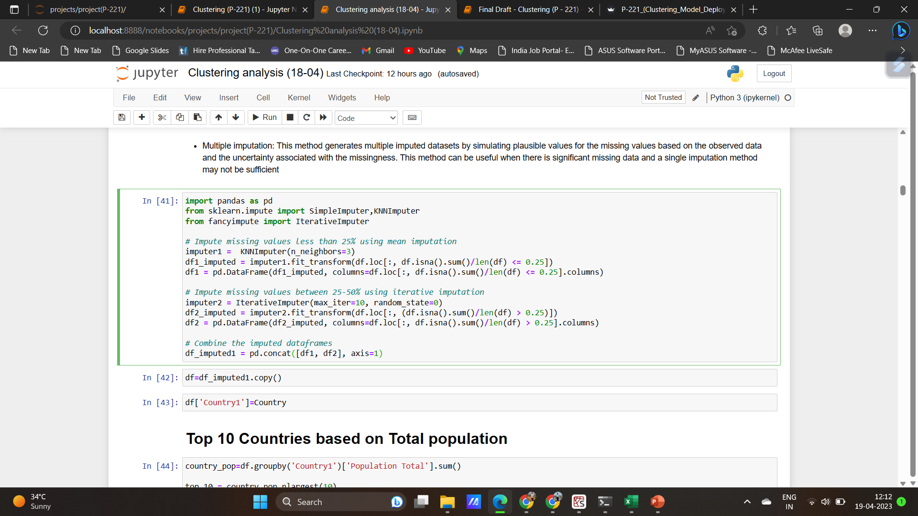
Imputation :
For missing values less than 25%, we can use simpler imputation methods like k-NN or median imputation.
For missing values more than 25%, we can use multiple imputation methods to generate multiple imputed datasets.
Multiple imputation: This method generates multiple imputed datasets by simulating plausible values for the missing values based on the observed data and the uncertainty associated with the missingness. This method can be useful when there is significant missing data and a single imputation method may not be sufficient

Slide 10
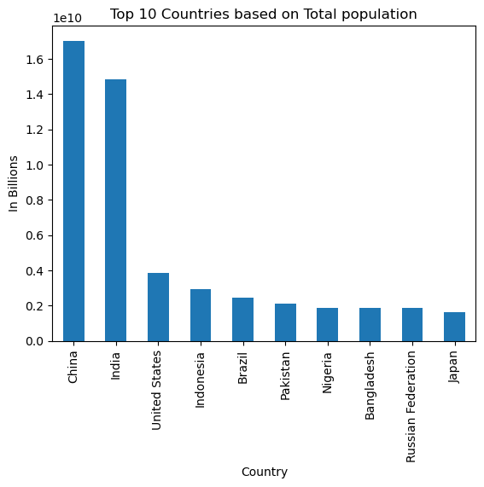
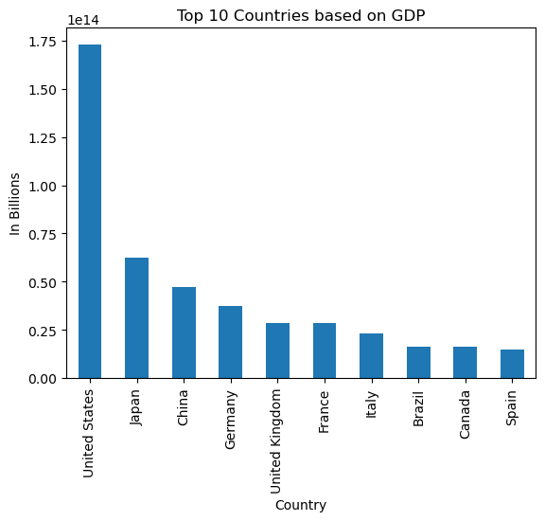
Top 10 Countries based on Total population and GDP

Slide 11
Top 10 Countries based on Total population and GDP
Population and GDP are the two most prominent factors determing the power of nation in general
In this manner the countries with most GDP and required Manpower can build all the necessary things because here the shortage of resourse would not be made

Slide 12
Countries health Expenditure
United States,spain,italy,norway,monoca,denmark is spending more on health care services ,also we can observe that life expectancy of male and female is more and also mortality rate of these countries are very low compare to countries which spend less for health expenditure
African Countries like myanmar,niger,ethiopia,madagascar is spending less on health care services,also countries like seirra leone,chad,congo.dom has got less life expectancy of both male and female and mortality rate is very for these countries,
The more spend on health expenditure refer to a developed or developing nation which symbolises the importance of the life

Slide 13
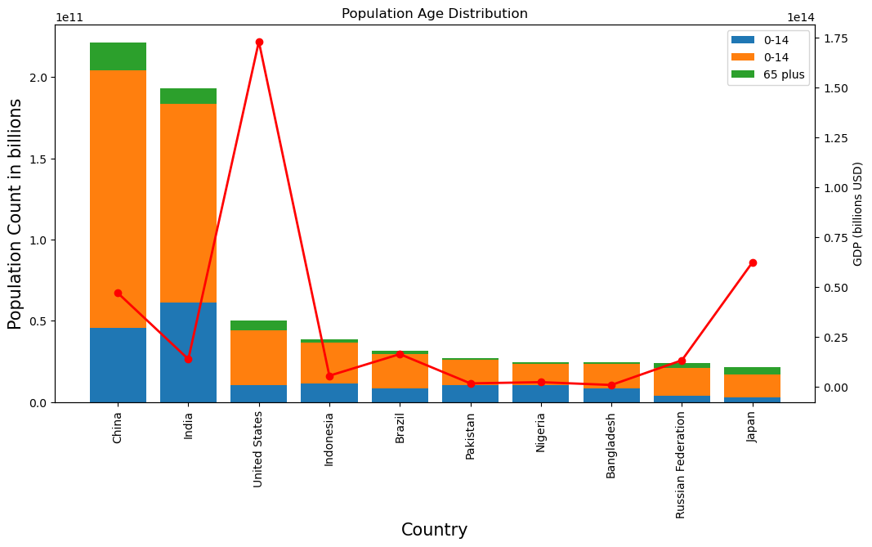
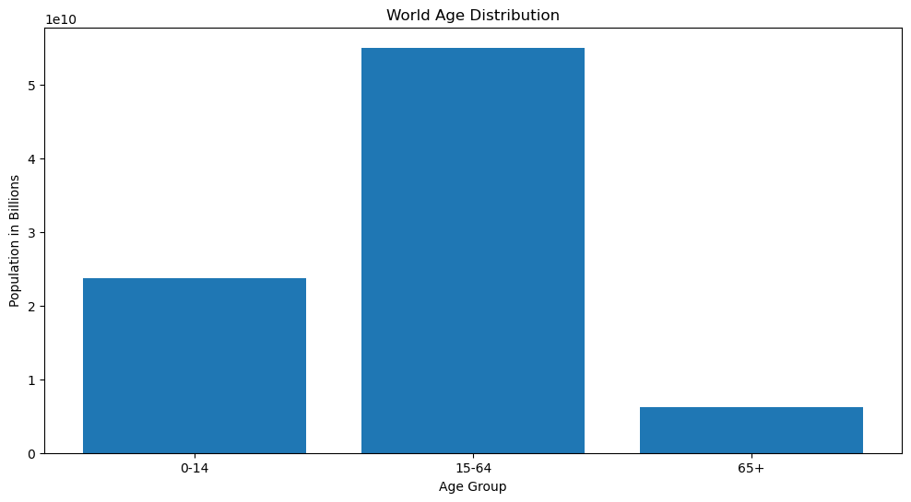
AGE distribution
The age distribution shows majority of world is the mid range working population
Also this population has impact on GDP irrespective of few cases

Slide 14
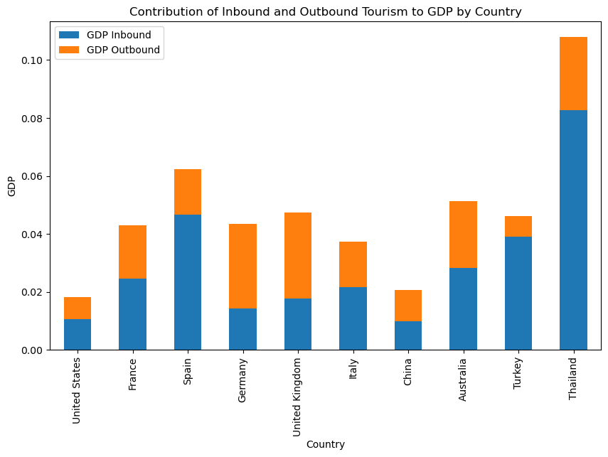
inbound and outbound tourism
inbound tourism means visits to a country by visitors who are not residents of that country.
outbound tourism means visits by residents of a country outside that country
The more of vistiors the GDP and also exchange of culture which leads to the global developement

Slide 15
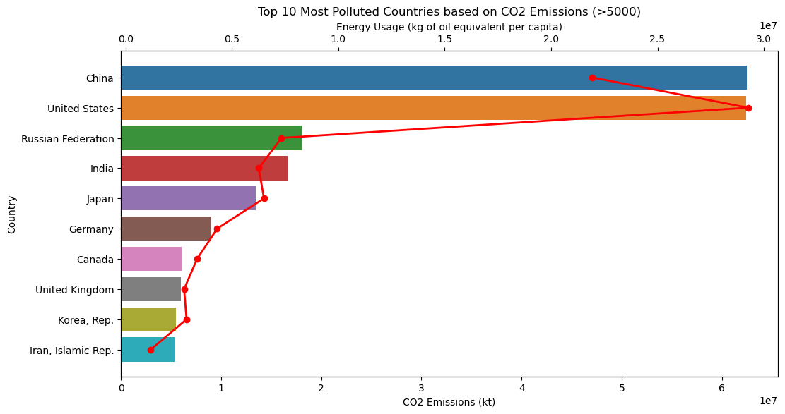
Polluton and energy usage
The top 10 countries in the world are responsible for a significant amount of global CO2 emissions and energy usage. China and the United States are the top two emitters, followed by Russia, India, Japan, and Germany. These countries are also among the top energy consumers in the world, with China and the United States
leading the pack again. Canada, the United Kingdom, Korea, and Iran also feature on this list
There is a correlation between a country's CO2 emissions and its energy usage. The top emitters are also the top energy consumers, which suggests that the two are related

Slide 16
correlation insights
The negative coefficients between Birth Rate and Life Expectancy (both for females and males) suggest that as the birth rate increases, the life expectancy of females and males tends to decrease. This can be explained by the fact that higher birth rates may lead to higher infant mortality rates, as well as increased strain on healthcare and resources, which can have negative impacts on overall health and life expectancy.
There is a strong positive relationship between Birth Rate and the proportion of the population that is aged 0-14, meaning that higher Birth Rates are associated with a higher proportion of children in the population.
there is a strong negative relationship between Birth Rate and the proportion of the population that is aged 15-64, meaning that higher Birth Rates are associated with a lower proportion of working-age adults in the population.
There is also a strong negative relationship between Birth Rate and the proportion of the population that is aged 65 or over, meaning that higher Birth Rates are associated with a lower proportion of elderly individuals in the population.
Population 0-14 and (Population 65+& Population 15-65), has a correlation coefficient of -0.892, indicating a strong negative relationship. This suggests that as the percentage of the population that is aged 0-14 increases, the percentage of the population that is aged 15-65+ tends to decrease, and vice versa.
Tourism Inbound and Tourism Outbound, has a correlation coefficient of 0.882, indicating a strong positive relationship. This suggests that as the number of inbound tourists to a country increases, the number of outbound tourists from that country tends to increase as well

Slide 17
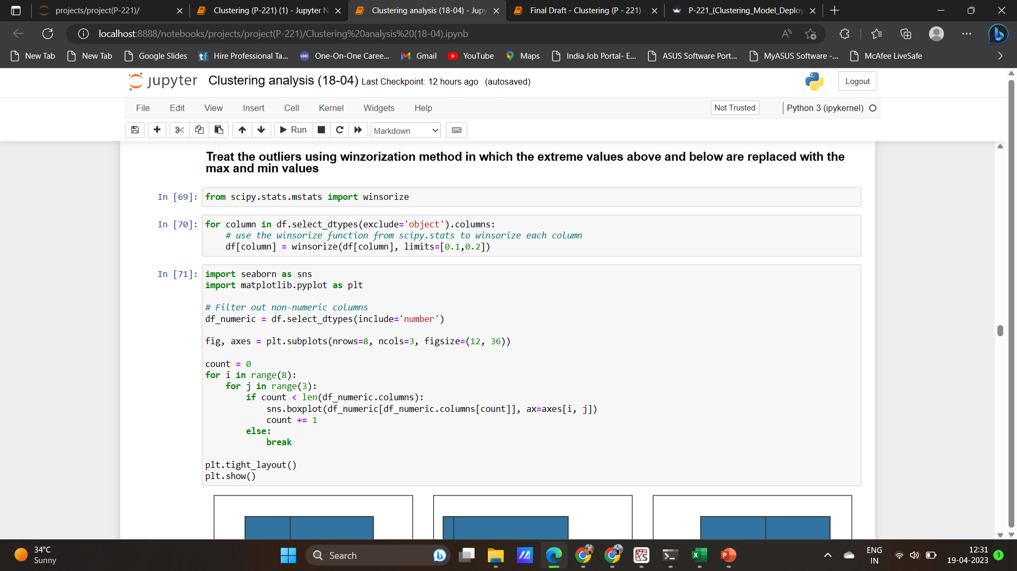
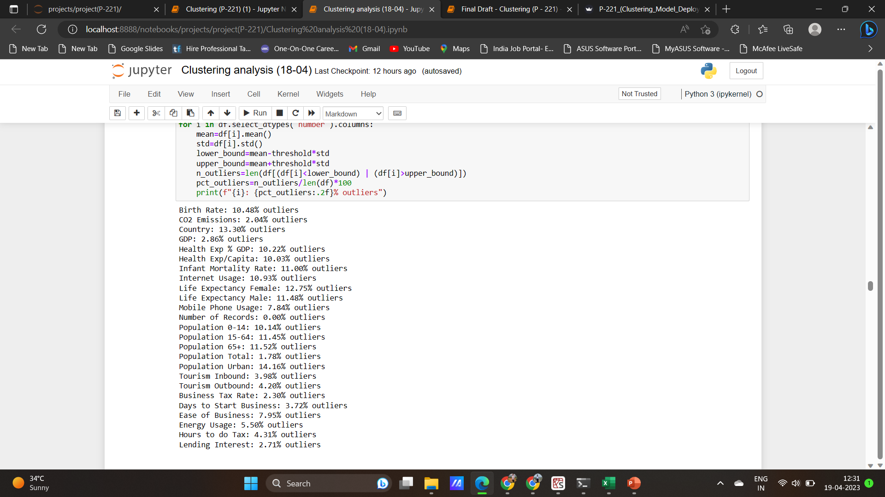
outliers and their treatment

Slide 18
processed data points
The average birth rate in the dataset is 0.023, with a standard deviation of 0.011. The minimum birth rate is 0.007, while the maximum is 0.053.
The average CO2 emissions are 114,169.5, with a standard deviation of 550,017.6. The minimum value is 7, while the maximum value is 8,286,892.
There are 2691 countries in the dataset, with an average value of 103.6845. The minimum country code is 0, while the maximum is 207.
The average GDP in the dataset is 245.6420 x 10^11, with a standard deviation of 1089.679 x 10^11. The minimum GDP is 63.10127 x 10^7, while the maximum GDP is 1.624460 x 10^13.
The average health expenditure as a percentage of GDP is 0.0638, with a standard deviation of 0.0249. The minimum value is 0.008, while the maximum is 0.225.
The average health expenditure per capita is 734.4757, with a standard deviation of 1402.998. The minimum value is 2, while the maximum is 9908.
The average infant mortality rate is 0.0316, with a standard deviation of 0.0288. The minimum value is 0.002, while the maximum is 0.141.
The average internet usage is 0.2314, with a standard deviation of 0.2544. The minimum value is 0, while the maximum is 1.
The average life expectancy for females is 71.3348, with a standard deviation of 10.4913. The minimum value is 39, while the maximum is 87.
The average life expectancy for males is 66.5779, with a standard deviation of 9.1883. The minimum value is 37, while the maximum is 88.
The average mobile phone usage is 0.5737, with a standard deviation of 0.4612. The minimum value is 0, while the maximum is 2.9.
There is only one record per country in the dataset, as indicated by the "Number of Records" statistics.
The average population percentage of people aged 0-14 is 0.3028, with a standard deviation of 0.1024. The minimum value is 0.118, while the maximum is 0.5.
The average population percentage of people aged 15-64 is 0.6249, with a standard deviation of 0.0671. The minimum value is 0.474, while the maximum is 0.858.
The average population percentage of people aged 65+ is 0.0718, with a standard deviation of 0.0479. The minimum value is 0.003, while the maximum is 0.244.
The average total population in the dataset is 31,608,960, with a standard deviation of 124,570,100. The minimum value is 18,876, while the maximum is 1,350,695,000.
The average population percentage living in urban areas is 0.562, with a standard deviation of 0.2447. The minimum value is 0.082, while the maximum is 1.
The average inbound tourism is 4,378,547, with a standard deviation of 12,984

Slide 19
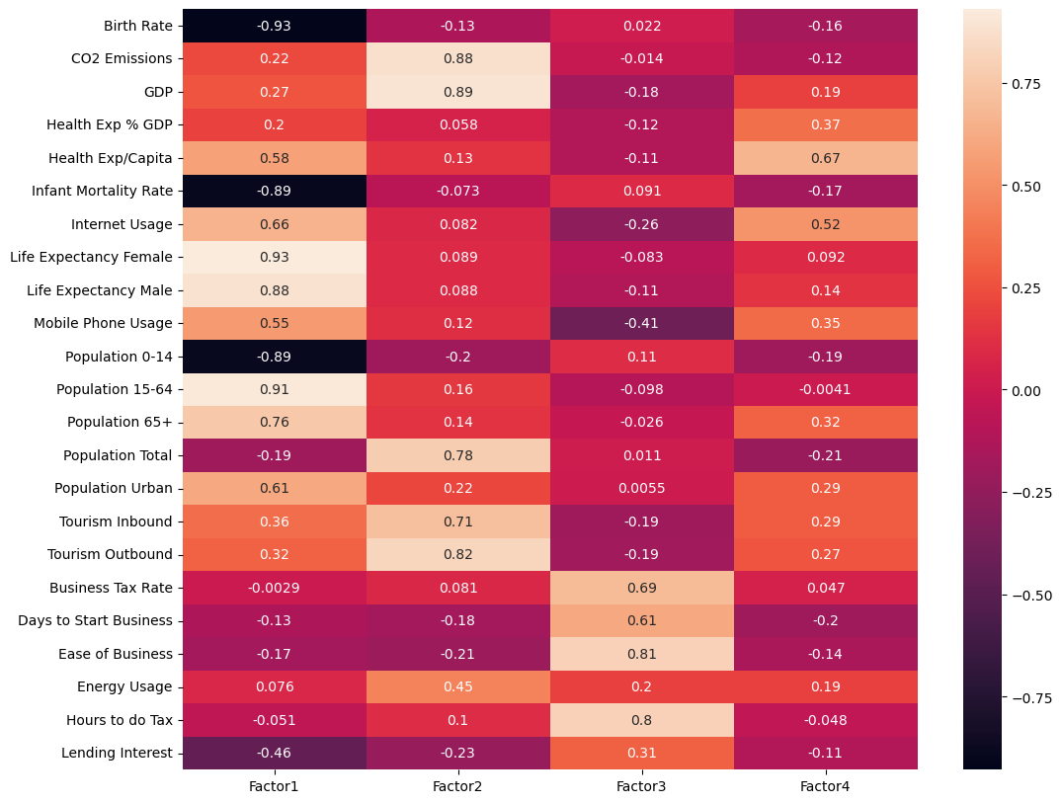
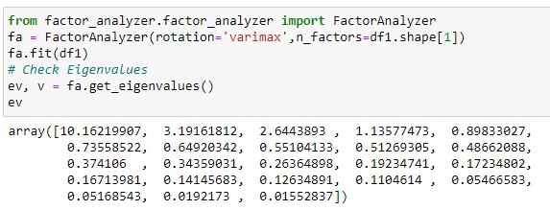
Factor analysis

Slide 20
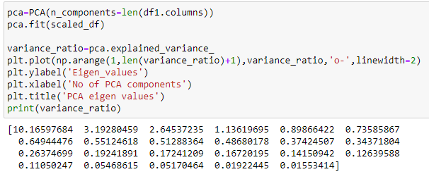
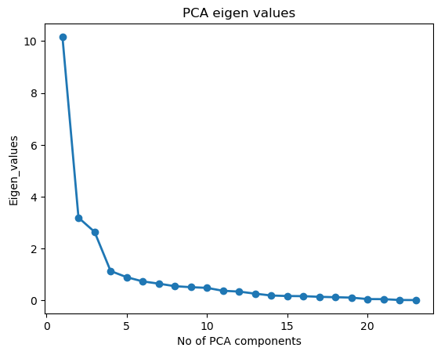
PCA

Slide 21
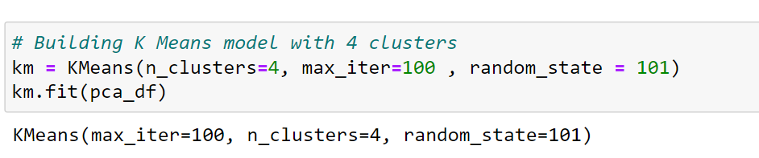
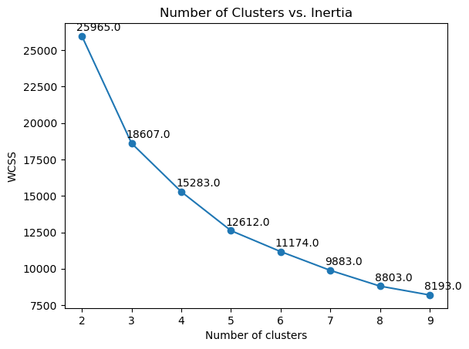
Model Building
After Feature scaling and we used PCA techniques to reduce the high dimensionality features into four pca components which has eigen values greater than 1.
We used K-means clustering,the no of clusters are decided by using wcss method or elbow curve as shown in the fig

Slide 22
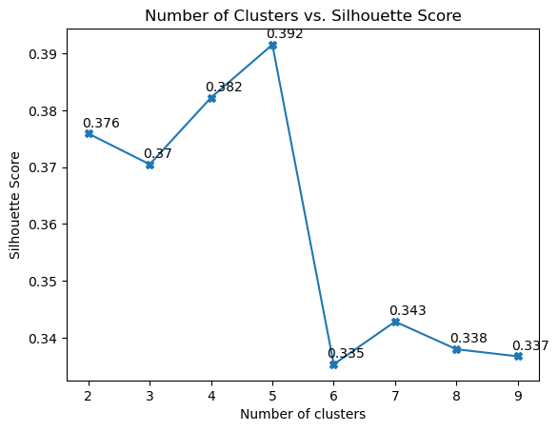
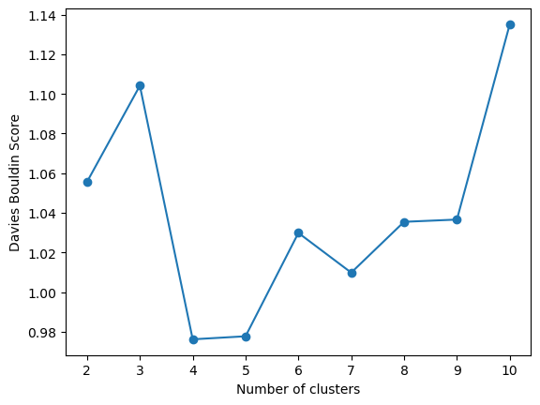
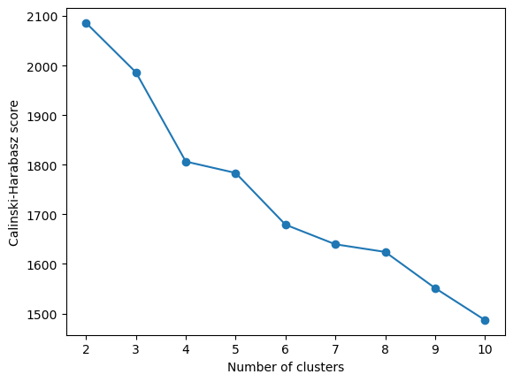
Metrics
Metrics used are silhouette score, Davies Bouldin Score, Cainski-Harabasz index
We got silhouette score around 0.392 for 4 clusters but we used metrics like Davies Bouldin Score, Cainski-Harabasz index
Based on Davies Bouldin Score, Cainski-Harabasz index, we decided to to go for the 4 clusters,
In Davies Bouldin Score we got lowest value for 4 clusters
Cainski-Harabasz index,we elbow curve around 4 clusters

Slide 23
Conclusions on K-Means Clustering
We used the measure of central tendency such as mean and median to compare the clusters
Cluster 0 has the lowest birth rate, low CO2 emissions, low GDP, low health expenditure, low infant mortality rate, and low internet usage. This suggests that Cluster 0 represents countries that are less developed or have lower economic activity compared to the other clusters(developing country)
Cluster 1 has high values for most of the features, including high CO2 emissions, high GDP, high health expenditure, high life expectancy, and high mobile phone usage. This indicates that Cluster 1 may represent highly developed countries or those with high economic activity.(highly developed countries-(socio-economically forward countries)
Cluster 2:This cluster includes countries with a low GDP per capita and relatively high birth rates and CO2 emissions. The health expenditure as a percentage of GDP is low, and the health expenditure per capita is relatively high compared to other clusters, indicating poor health services. The infant mortality rate is also relatively high in this cluster. The population is mostly urban and relatively young, with a high percentage of people aged 0-14 and a low percentage of people aged 65+. Inbound tourism is relatively low, indicating a struggling economy(Least Developed--(socio-economically backward countries/under developed countries)
Cluster 3:This cluster comprises moderately developed countries with high birth rates, CO2 emissions, and GDP per capita. However, the health expenditure as a percentage of GDP and per capita is relatively low, and the infant mortality rate is high. The population in this cluster is predominantly young and urban, with a high percentage of people aged 0-14 and a low percentage of people aged 65+. Inbound tourism is also relatively high in this cluster.(Moderately Developed)

Slide 24
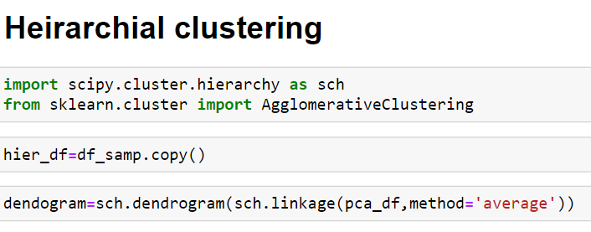
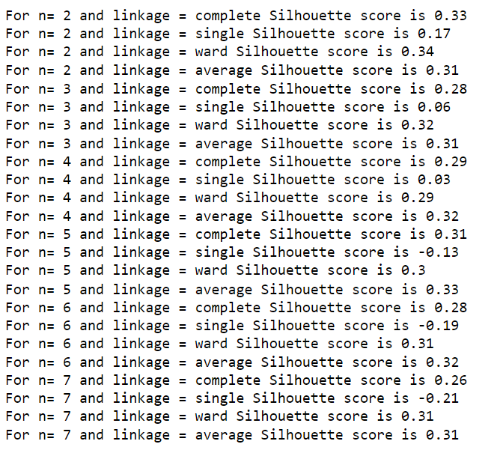
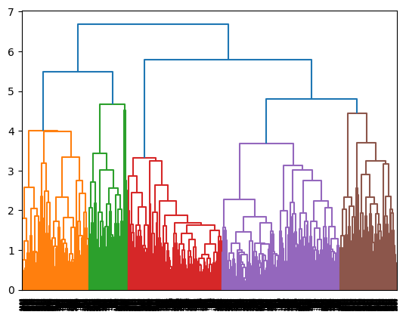
Based on silhouette score,we decided to go for the 4 clusters and linkage as ‘average’ and we got silhouette score as 0.32

Slide 25
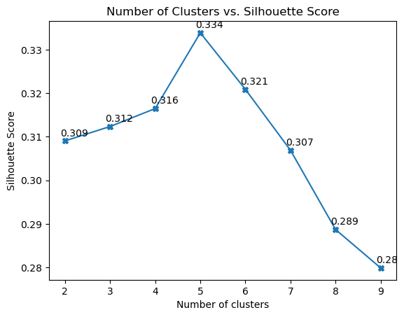
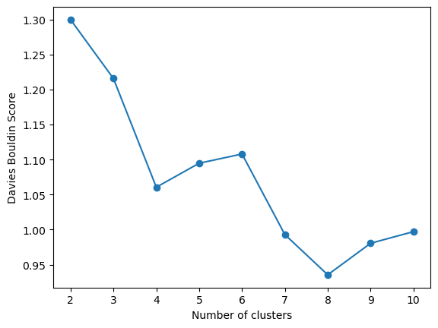
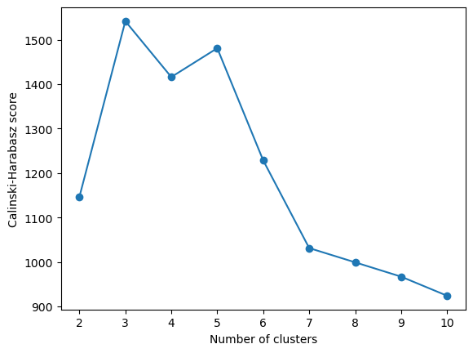
Metrics
Metrics used are silhouette score, Davies Bouldin Score, Cainski-Harabasz index
We got silhouette score around 0.316 for 4 clusters but we used metrics like Davies Bouldin Score, Cainski-Harabasz index
In Davies Bouldin Score we got lowest value for 8 clusters
Cainski-Harabasz index,we elbow curve around 4 clusters

Slide 26
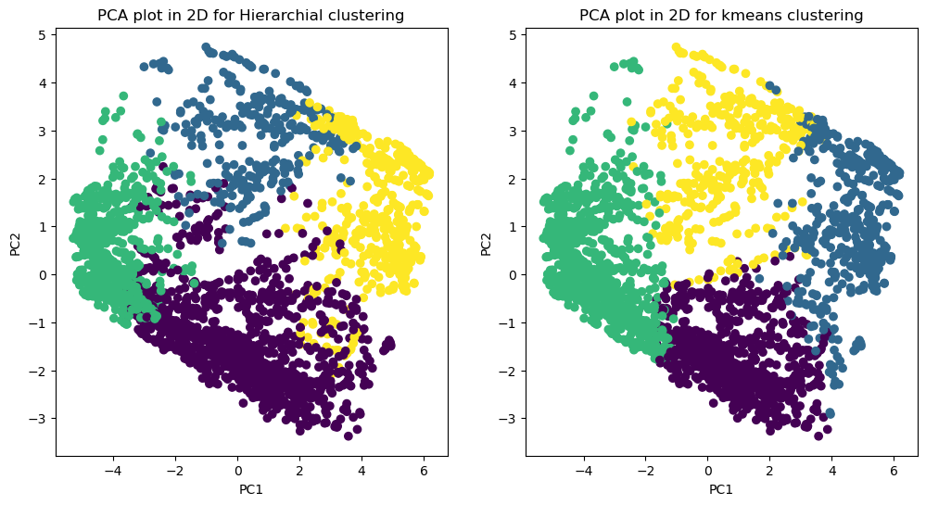
Comparisons between K-means and hierarchial clustering
As per above plot we can see that k-means has clustered pca components well as compared to the Hierarchial clustering so we will conclude k-means as final model for the Deployment

Slide 27
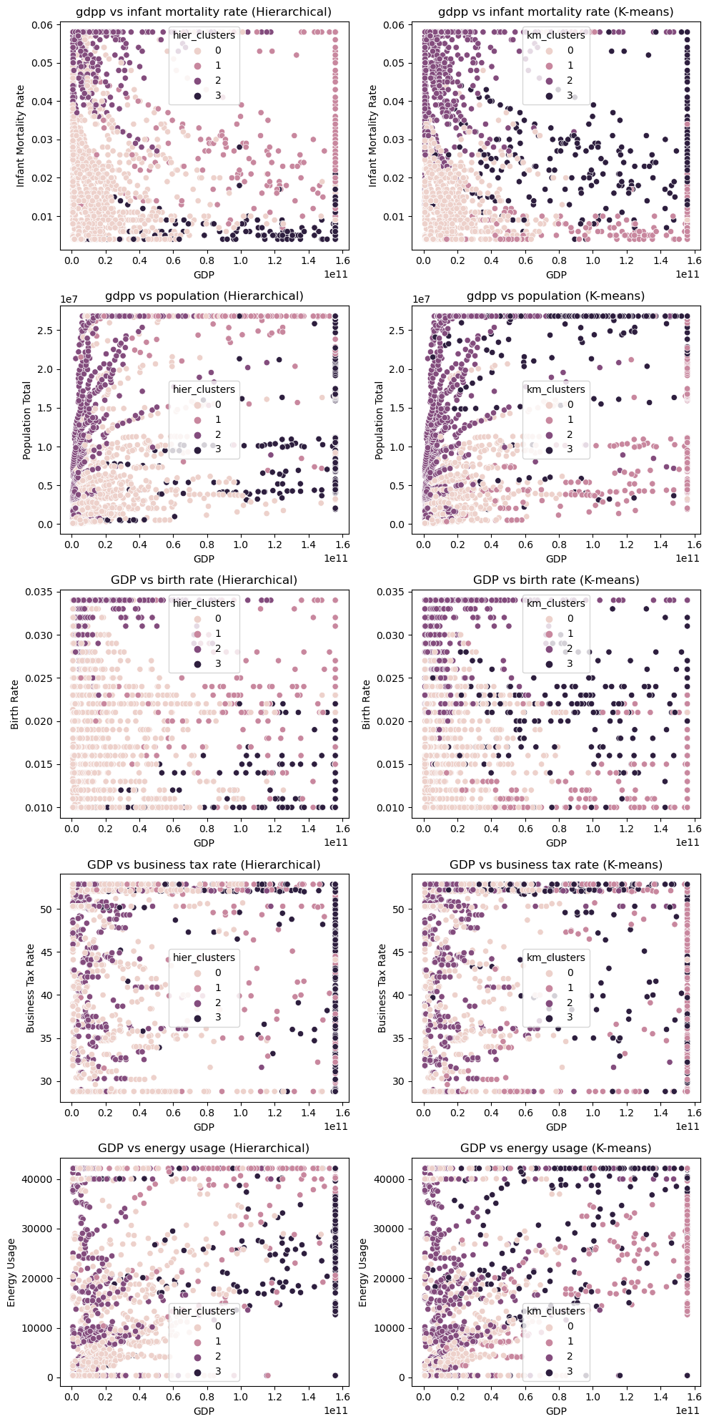
Comparisons between K-means and hierarchial clustering
We compared the kmeans and hierarchial clustering with some of the features such as population,GDP,,birth rate,Buisness tax rate
So both clustering are quite similar as we can see in the plot

Slide 28

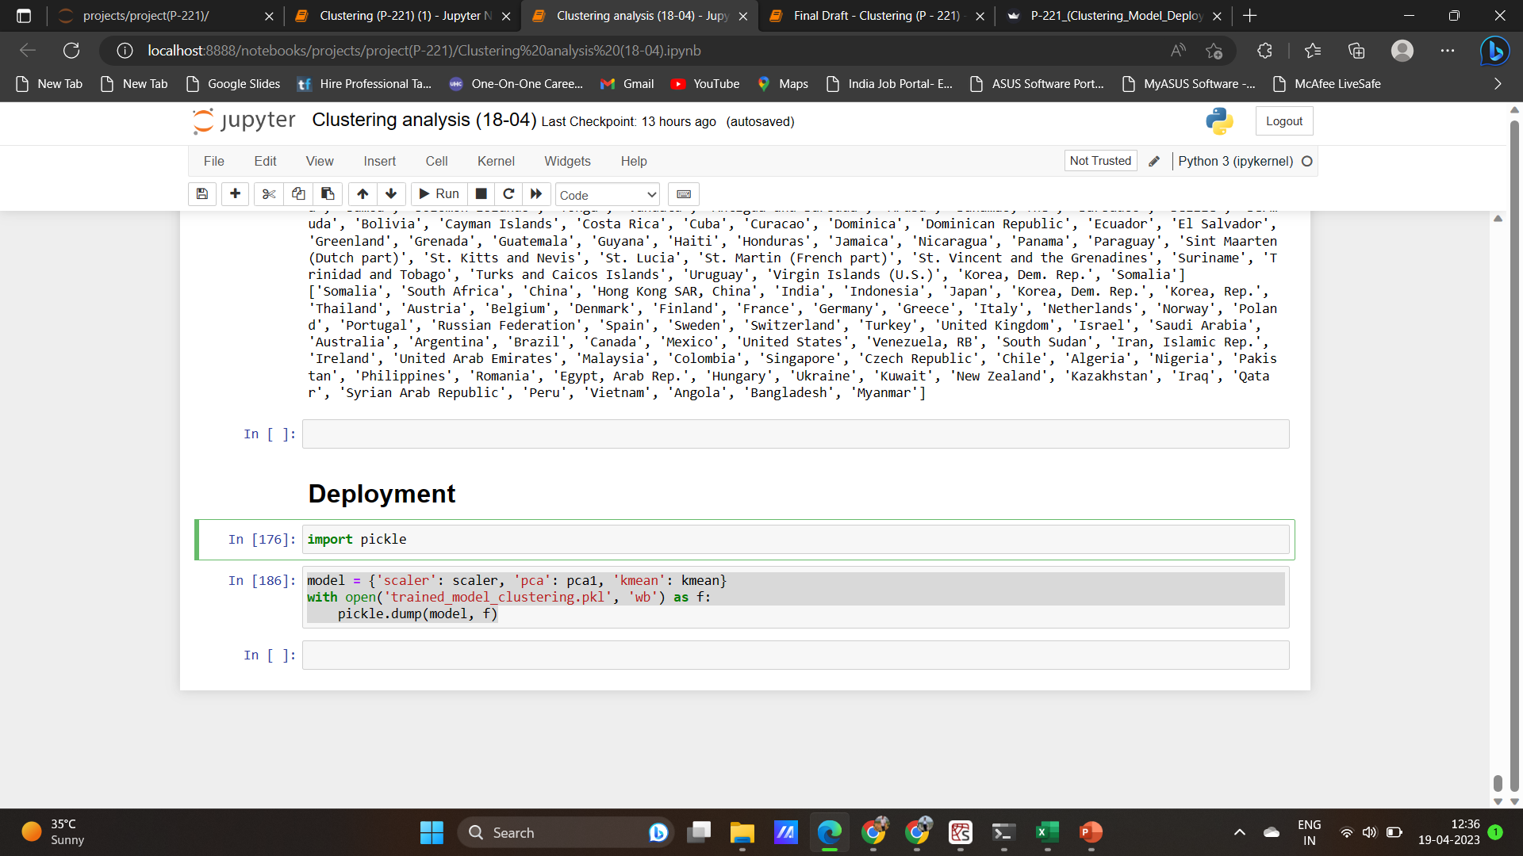
Deployment
The final model is dumped in pickle along the necessary transformations and all deployment is carried over with stream lit
This app file is made in way that the values are entered within a range

Slide 29
Thank You

